Slide 1
CS 2060 Final Project Presentation
Joshua Edwards

Slide 2
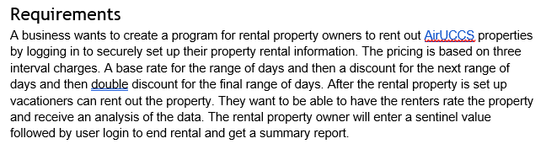
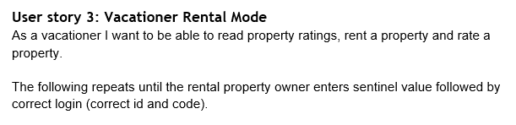

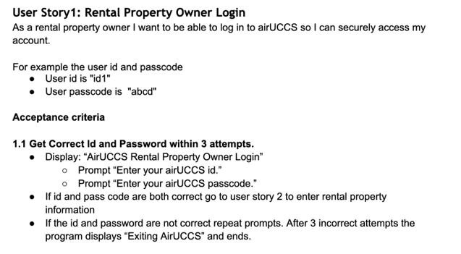
Analyze complex requirements and user stories

Slide 3
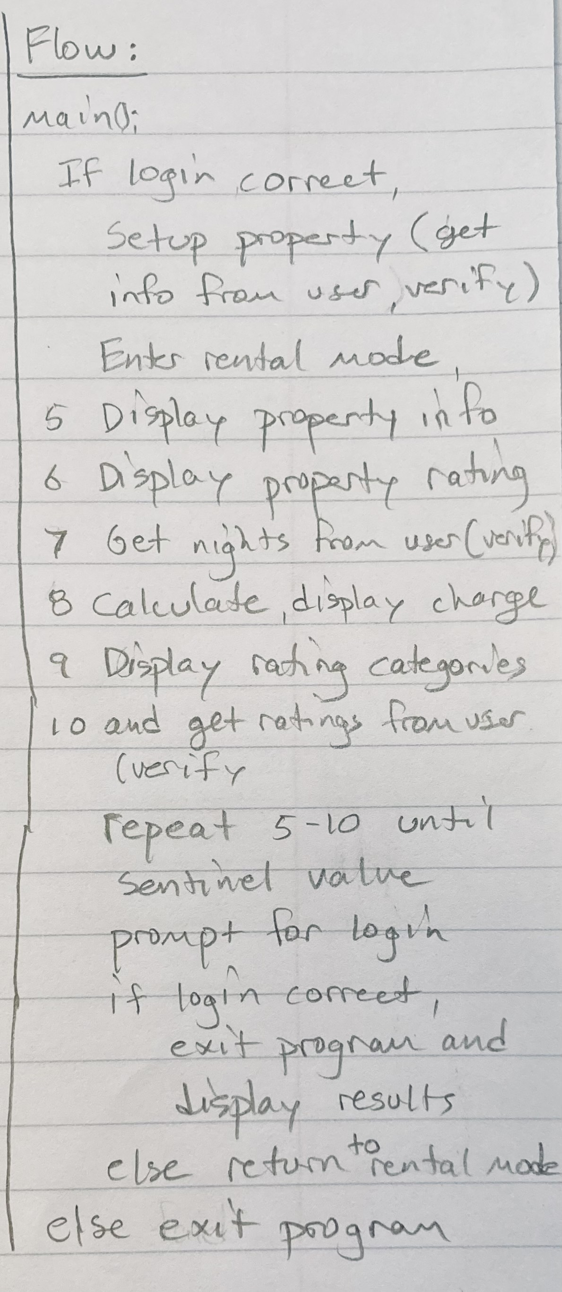
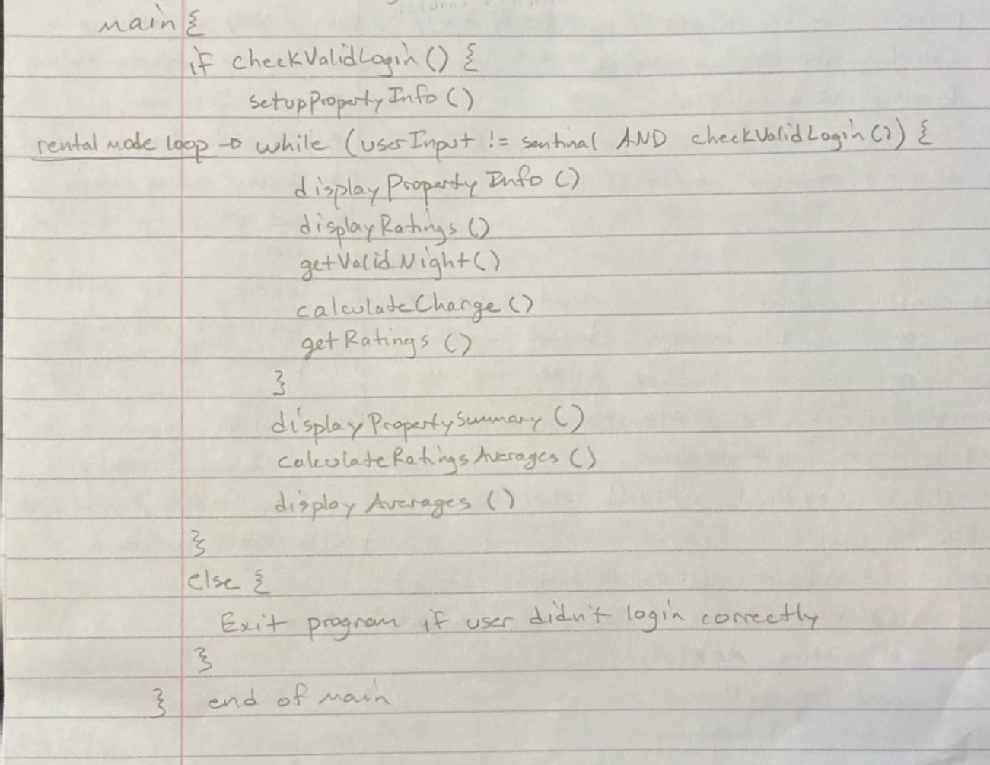
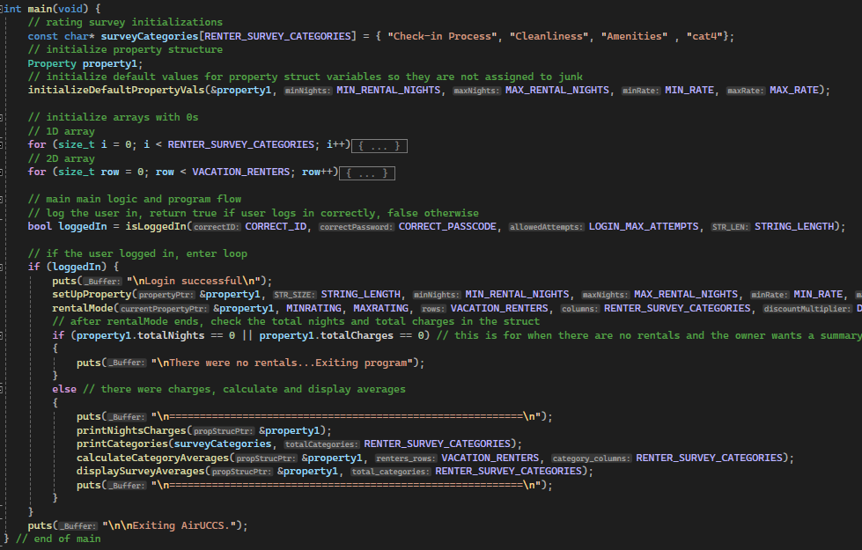
Design and implement solution to meet requirements
From a program flow diagram…
..to function pseudocode…
..into code

Slide 4
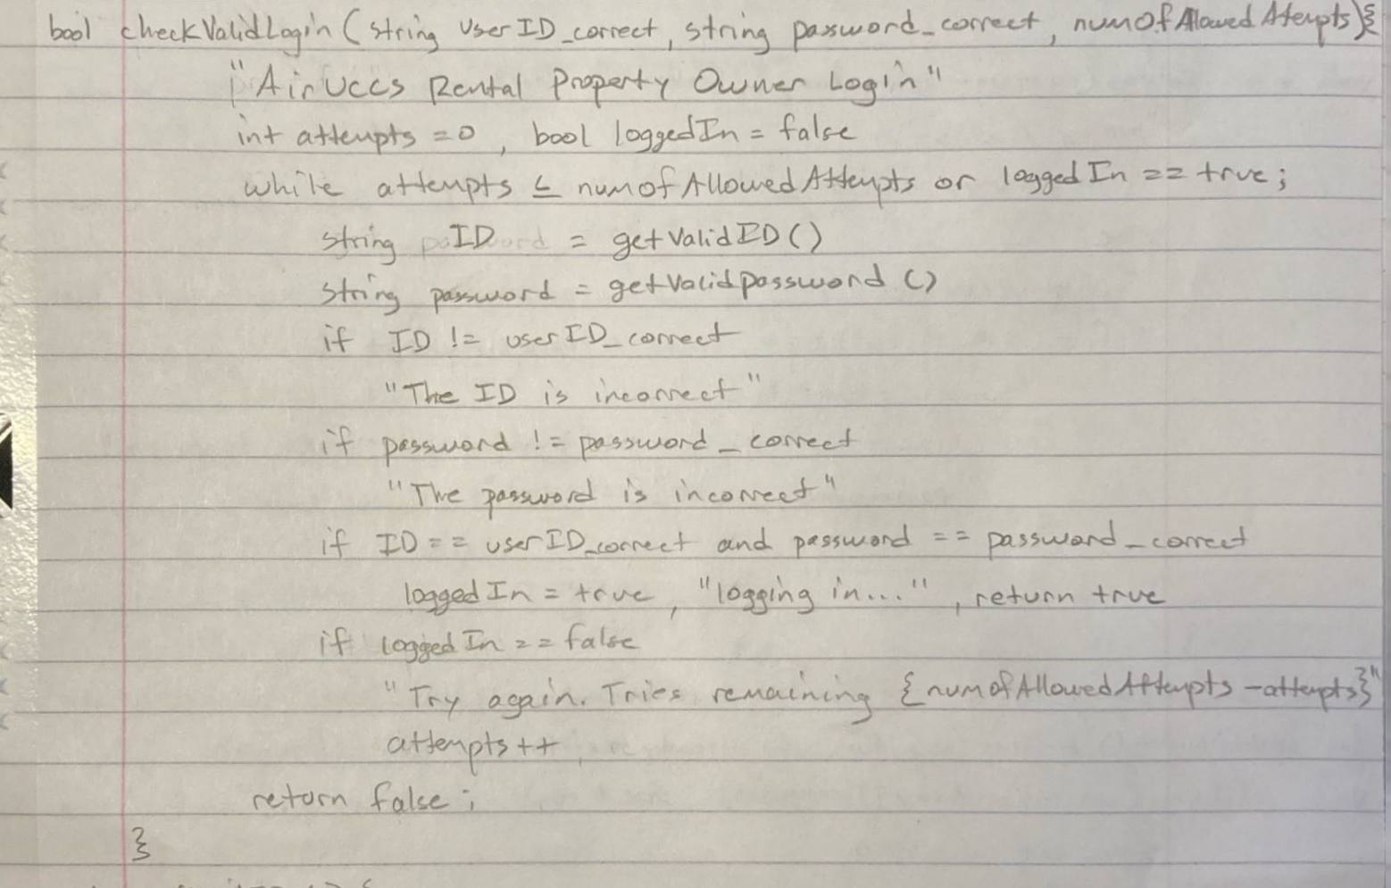
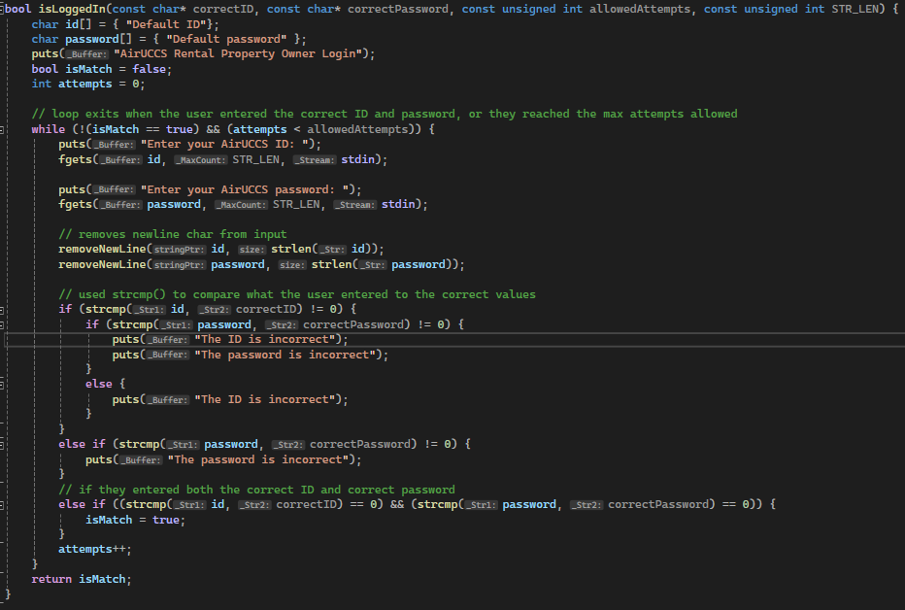
Implementation
Design

Slide 5
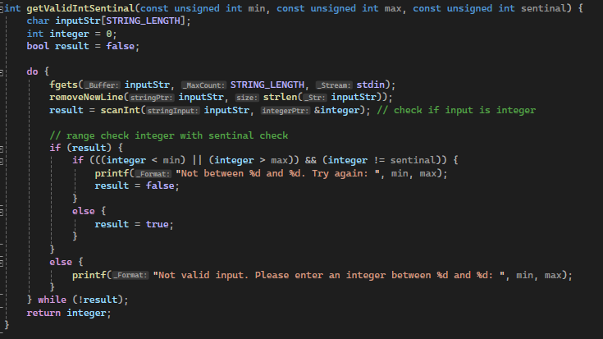
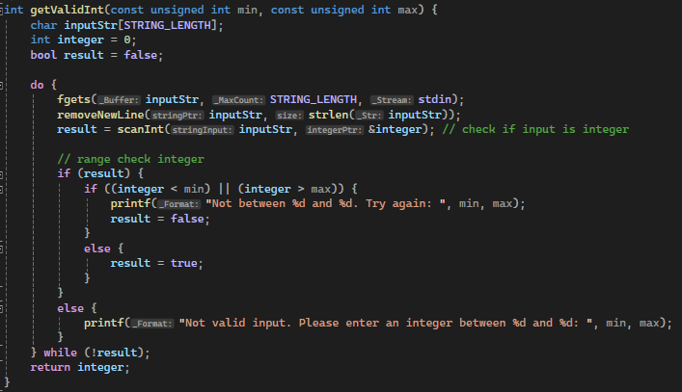

Implemented structured programming - Maintainable and Extendable Code
Used standard C logic structuring to avoid unnecessary breaks and loops. Created functions with SRP (Single Responsibility Principle) in mind and reduced repeated code with DRY principle (Do not repeat yourself)

Slide 6
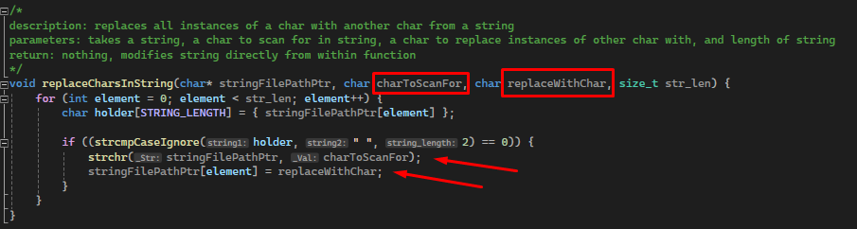
Implemented structured programming - Example 2
Did not hard code values

Slide 7
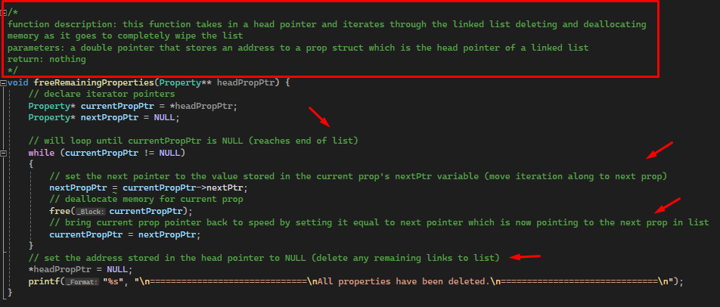
Quality readable code (descriptive comments)

Slide 8
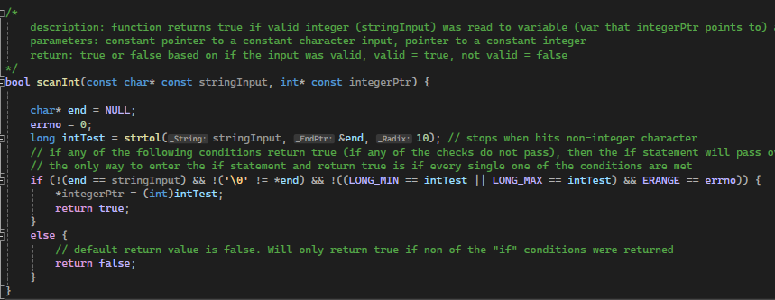
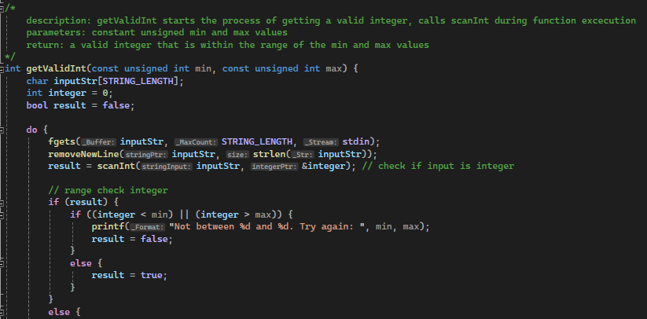
Secure coding practices
Input validation

Slide 9
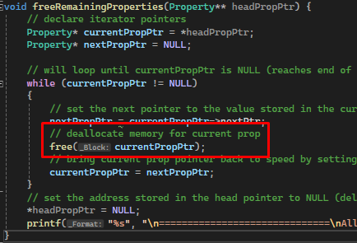
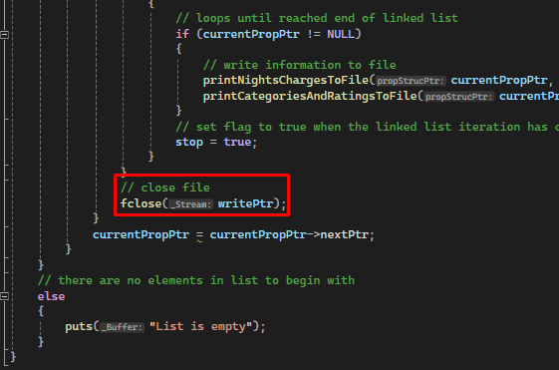
Secure programming – Example 2
Closed files and deallocated memory to prevent memory leaks

Slide 10
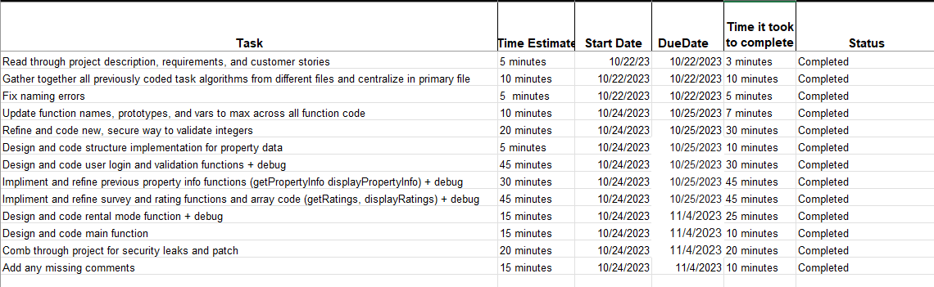
Project planning

Slide 11
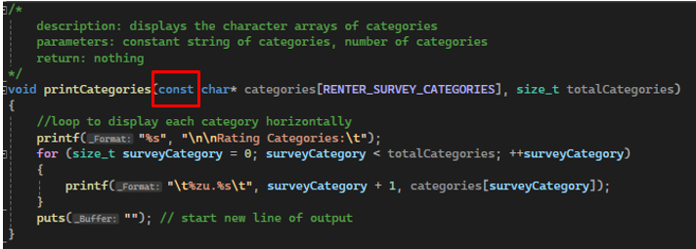
Principle of least privilege
Used const qualifier when function did not need permission to update variables

Slide 12
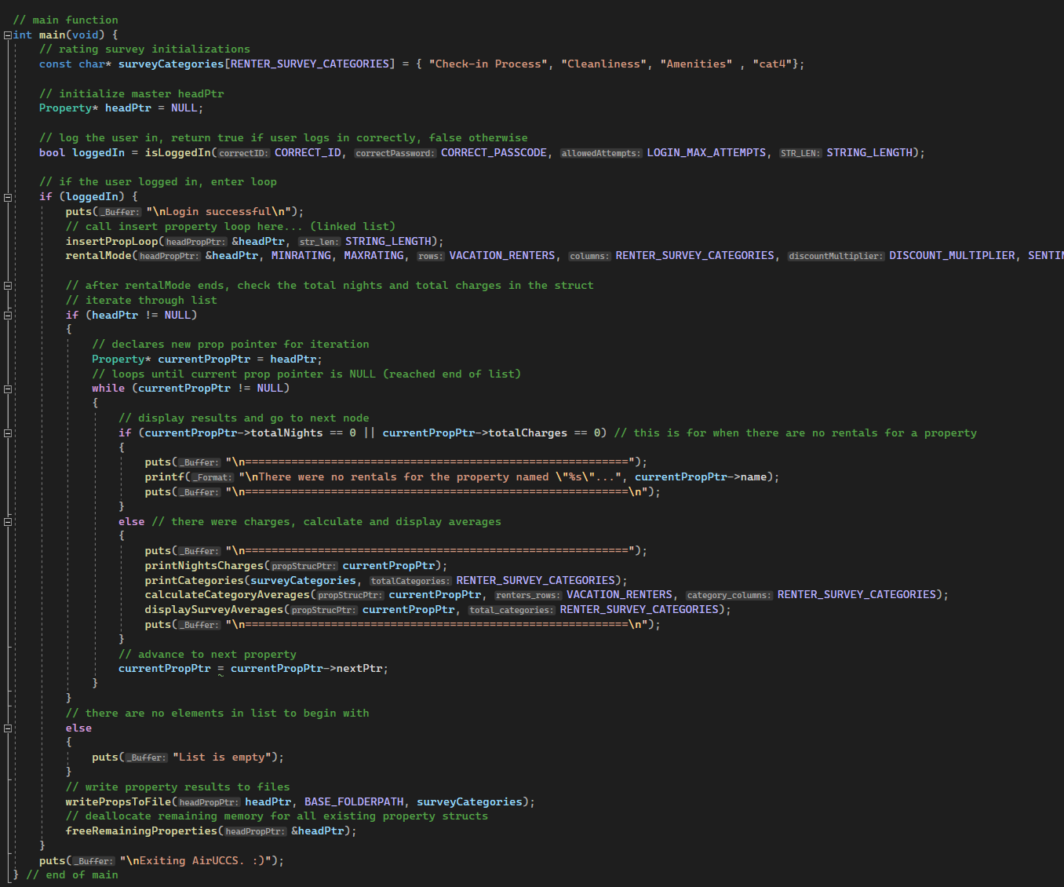
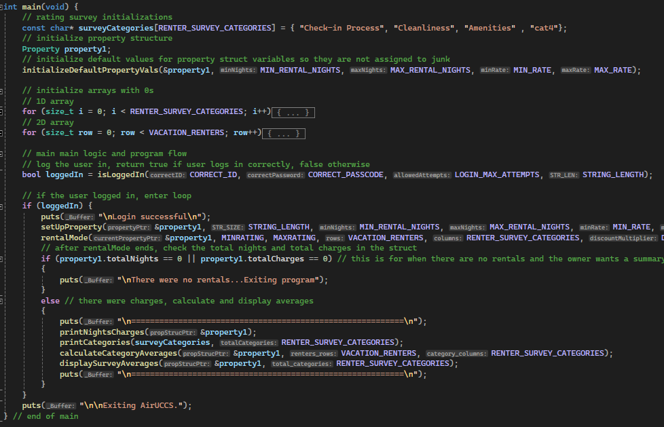
Refactored and cleaned code
Removed complex main logic
Old
New

Slide 13
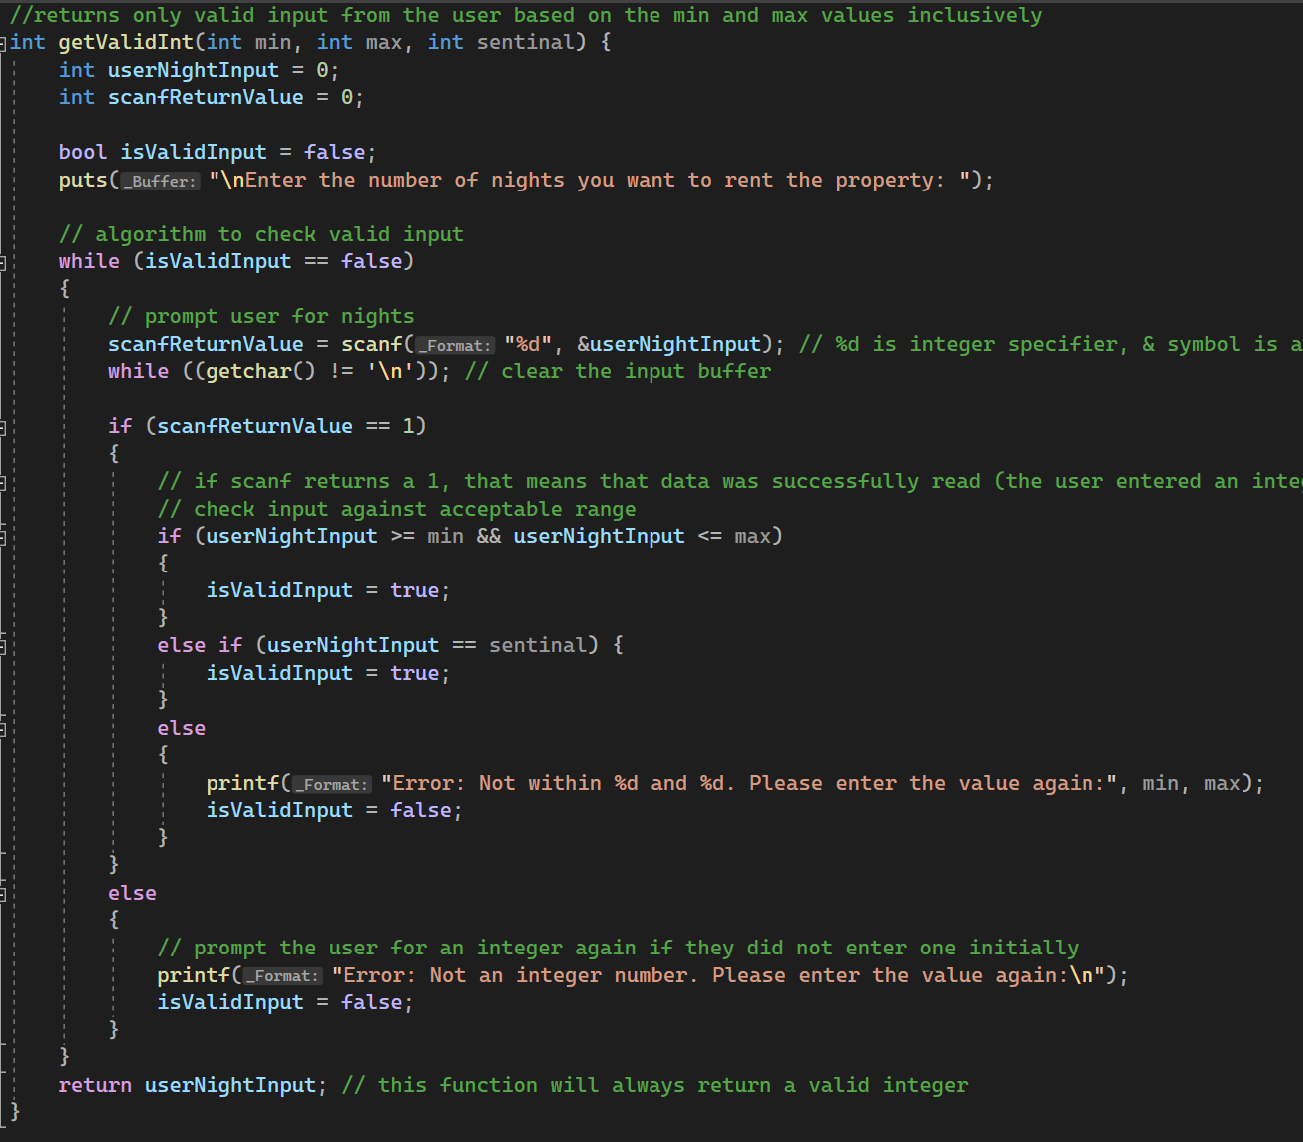
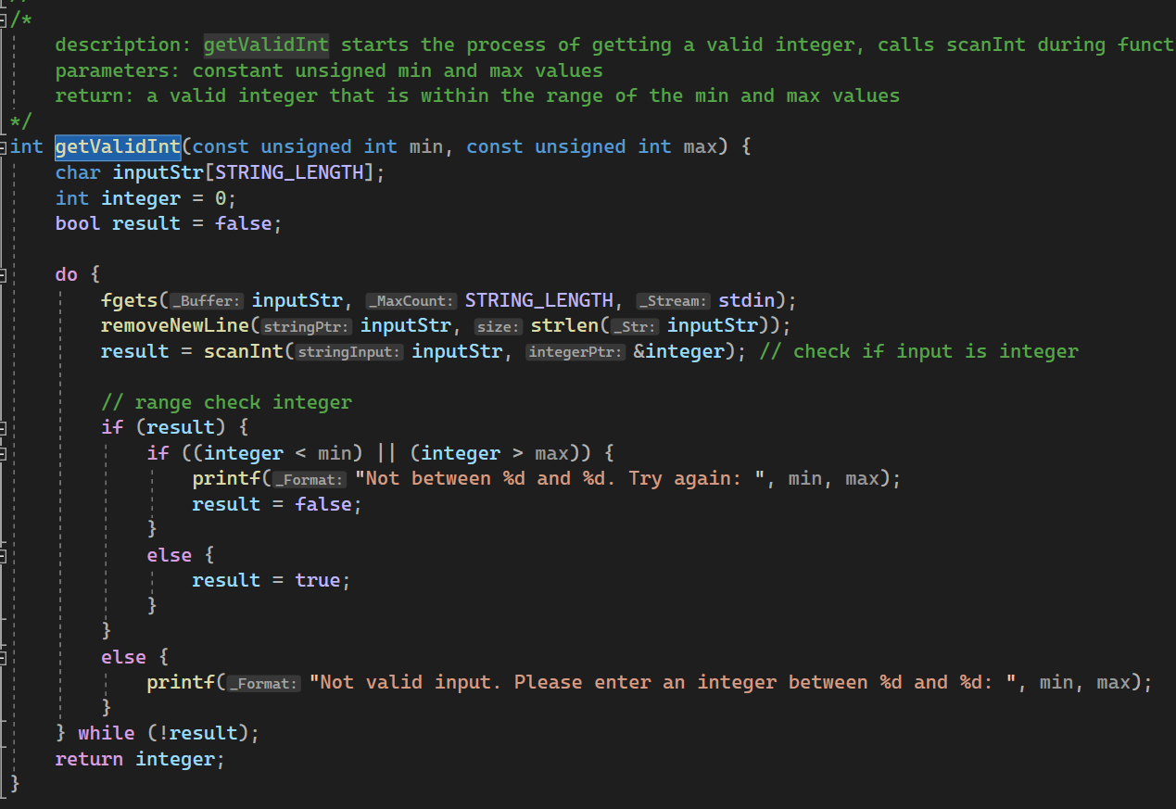
Refactored input validation function to be more secure

Slide 14
Video presentation about linked lists and dynamic memory allocation:
https://youtu.be/15Q8dMidcEI

